Slide 1




«MORBID OBESITY IN A PATIENT WITH A PREVIOUS MASON VERTICAL BANDED GASTROPLASTY: REVISION WITH ROUX-EN-Y GASTRIC BYPASS»
Pavone Giovanna
Speaker: Khoury Elizabeth
Dipartimento di Scienze mediche e chirurgiche
Università di Foggia
U.O.C Chirurgia Generale Universitaria
Direttore Prof. A. Ambrosi
Scuola di specializzazione in chirurgia generale
Direttore Prof. N. Tartaglia

Slide 2
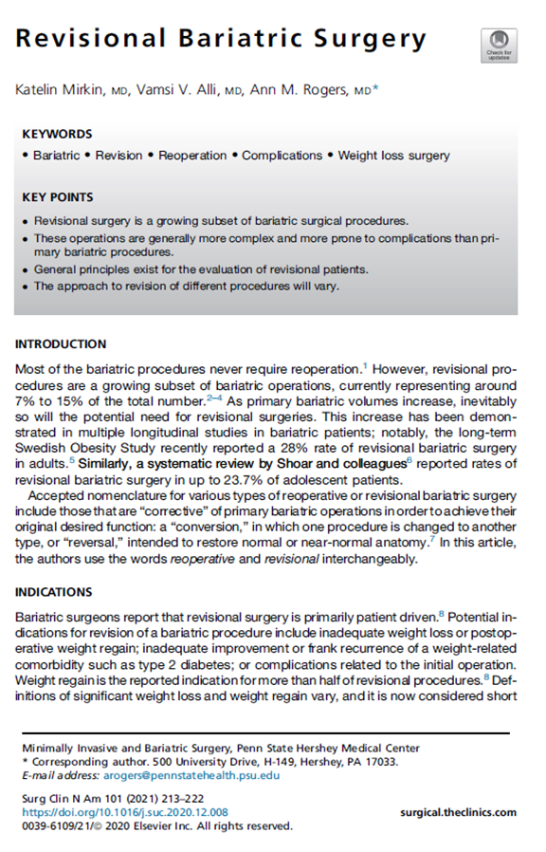
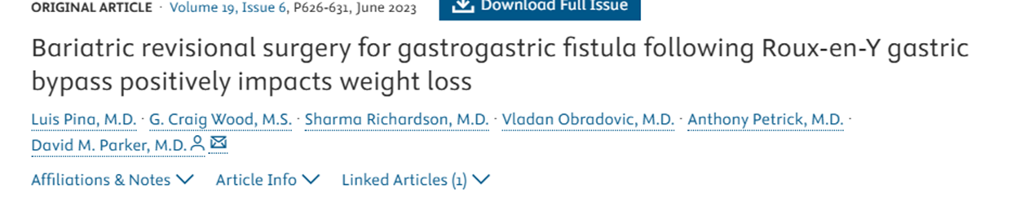

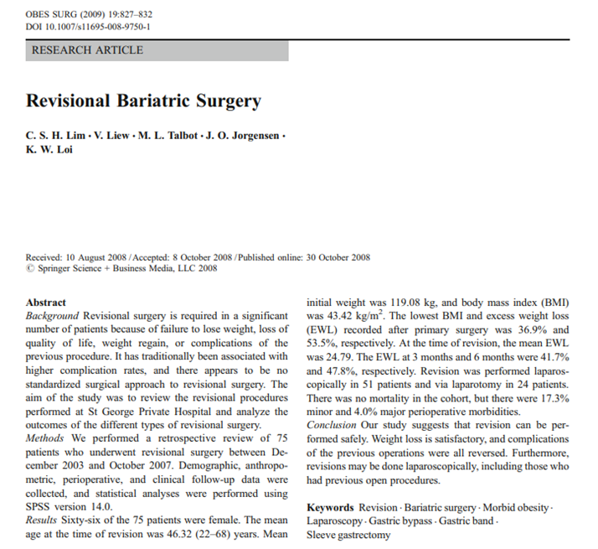
INTRODUCTION | CASE PRESENTATION | FOLLOW UP | CONCLUSIONS
Bariatric surgery is an effective treatment for morbid obesity resistant to conservative therapies.
Revisional surgery is indicated for weight loss failure or postoperative complications.

Slide 3
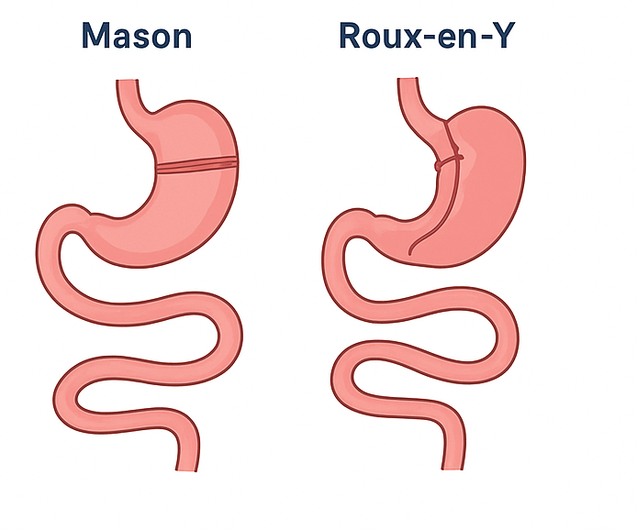
INTRODUCTION | CASE PRESENTATION | FOLLOW UP | CONCLUSIONS
This case reports the management of a patient with prior Mason vertical banded gastroplasty complicated by fistulization between gastric pouches.
The patient underwent revisional Roux-en-Y gastric bypass

Slide 4
INTRODUCTION | CASE PRESENTATION | FOLLOW UP | CONCLUSIONS
35-year-old female with severe obesity (BMI 45.7; weight 109 kg; height 154.4 cm).
Progressive weight gain since age 18, unresponsive to dietary interventions.
Fat mass: 54.4% (bioelectrical impedance analysis).
Preoperative assessment:
– Cardiac: EF 55%, no active symptoms.
– Psychological: adequate insight and motivation.
Fit for surgery from all perspectives.

Slide 5
INTRODUCTION | CASE PRESENTATION | FOLLOW UP | CONCLUSIONS
Laparoscopic Roux-en-Y gastric bypass performed on June 10, 2025
No intraoperative complications
Postoperative imaging: normal transit through gastrojejunal anastomosis
No leaks or major complications detected

Slide 6
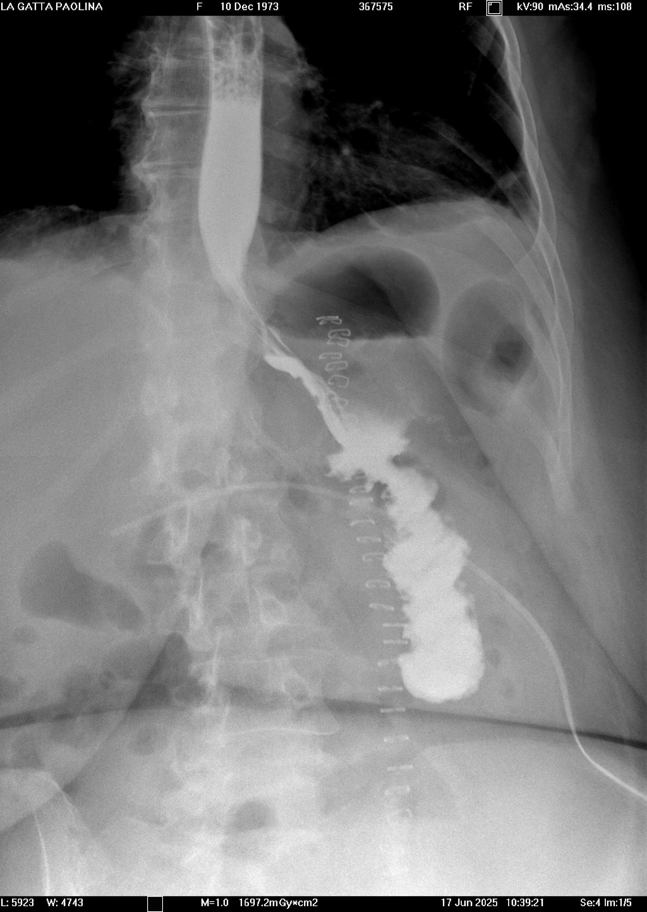
INTRODUCTION | CASE PRESENTATION | FOLLOW UP | CONCLUSIONS
“Al preliminare esame diretto non segni di aria libera a sede subfrenica. Presenza di tubo di drenaggio con estremo distale proiettivamente in ipocondrio dx. Si documentano nella regione del fianco destro, alcuni piccoli livelli idroaerei. Dopo somministrazione per os di mdc si evidenzia regolare il transito esofageo , con opacizzazione del moncone gastrico e dell'anastomosi gastro-digiunale senza evidenti spandimenti extra luminali di mdc in sede perianastomotica. Progressiva opacizzazione delle anse digiunali a valle che peraltro presentano contestuali livelli idroaerei con ristagno di contrasto a monte a livello del moncone gastrico. Si documentano alcuni episodi di reflusso gastro-esofageo in Trendelemburg.”

Slide 7
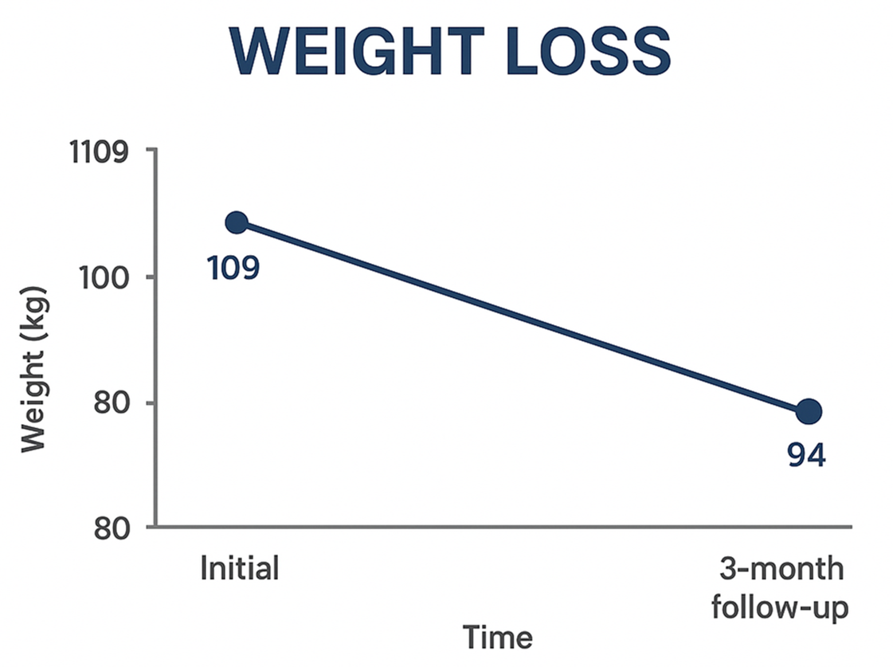
INTRODUCTION | CASE PRESENTATION | FOLLOW UP | CONCLUSIONS
3-month follow-up (September 2025):
– Weight: 94 kg (−13.8% total body weight loss)
– Improved satiety and dietary adherence
– No gastrointestinal complaints
• Gastric bypass proved effective as revisional surgery
after failed Mason gastroplasty

Slide 8
INTRODUCTION | CASE PRESENTATION | FOLLOW UP | CONCLUSIONS
SURGERY
Revisional Roux-en-Y gastric bypass
is a safe and effective option
for failed Mason vertical banded gastroplasty.
PREOPERATIVE DATA
Thorough preoperative multidisciplinary assessment is essential.
POSTOPERATIVE DATA
Careful postoperative follow-up ensures optimal outcomes and patient safety.

Slide 9


Grazie per l’attenzione

